Slide 1

CIT-2180 Data and Database Management Chapter 5

Slide 2

Oracle 12c: SQL
Chapter 5
Data Manipulation and Transaction Control

Slide 3
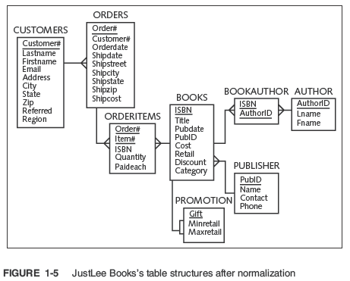

Slide 5
INSERT Command
Used to add rows to existing tables
Identify the table in the INSERT INTO clause
Specify data in the VALUES clause
Can only add one row at a time to a table

Slide 6
INSERT Command Syntax
Enclose nonnumeric data in single quotes
If a column list is not provided, a value must be assigned to each column in the table

Slide 7
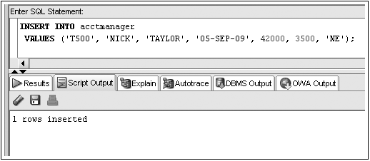
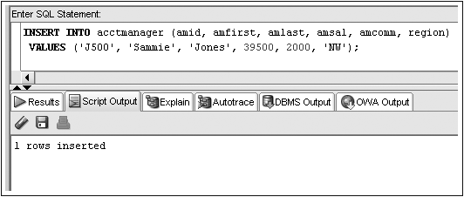
INSERT Command Examples
No Column List
Column List

Slide 8
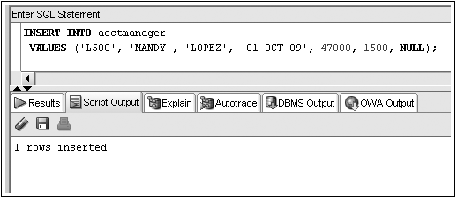
Inserting NULL Value
Omit column name from INSERT INTO clause column list
Substitute two single quotation marks
Use NULL keyword

Slide 9
Constraint Violations
When you add or modify table data, the data is checked for compliance with any applicable constraints

Slide 10
Activating the DEFAULT option
Include a column list in the INSERT statement ignoring the column to use the DEFAULT option
Use the DEFAULT keyword as the value for the column

Slide 11
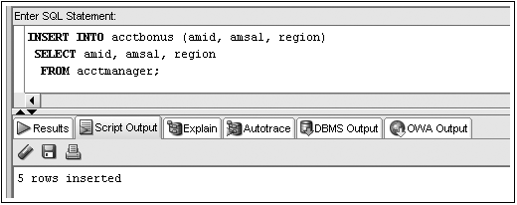
Inserting Data from an Existing Table
Substitute subquery for VALUES clause
Subquery

Slide 12
Modifying Existing Rows
Modify rows using UPDATE command
Use UPDATE command to:
Add values to an existing row (replace NULL values)
Change existing values

Slide 13

UPDATE Command
UPDATE clause identifies table
SET clause identifies column(s) being changed and new value(s)
Optional WHERE clause specifies row(s) to be changed – if omitted, all rows will be updated!

Slide 14
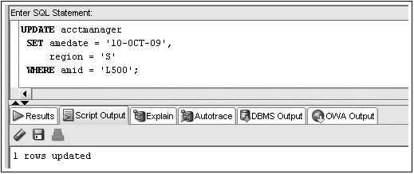
UPDATE Command Example

Slide 15
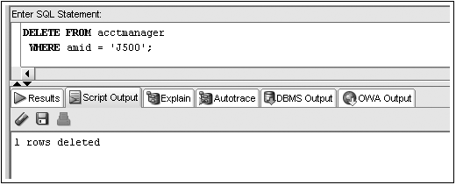
Deleting Rows
DELETE command removes a row from a table

Slide 16
DELETE Command – Omitting WHERE Clause
Omitting WHERE clause removes all rows

Slide 17
Transaction Control Statements
Results of data manipulation language (DML) are not permanently updated to a table until explicit or implicit COMMIT occurs
Transaction control statements can:
Commit data through COMMIT command
Undo data changes through ROLLBACK command

Slide 18
COMMIT Command
Explicit COMMIT occurs by executing COMMIT;
Implicit COMMIT occurs when DDL command is executed or user properly exits system
Permanently updates table(s) and allows other users to view changes

Slide 19
ROLLBACK Command
Used to “undo” changes that have not been committed
Occurs when:
ROLLBACK; is executed
System restarts after a crash
SAVEPOINT marks a specific spot within the transaction
Can ROLLBACK to a SAVEPOINT to undo part of the transaction

Slide 20
Topics not Discussed
We will not cover pages 168 – 170
USING TABLE LOCKS

Slide 21
Oracle 12c: SQL
END OF Chapter 5
Data Manipulation and Transaction Control

